Slide 1
Data Engineering Best Practices
Kerry Nakayama

Slide 2
Summary & Putting it all Together
Kerry Nakayama

Slide 3

Objectives
All the Roles
Role of a Data Engineer
All the Tools
How do they work together
Data design Studies
Extract
Transform
Load
Best Practices
Deployment Plan
Cultural Shift

Slide 4
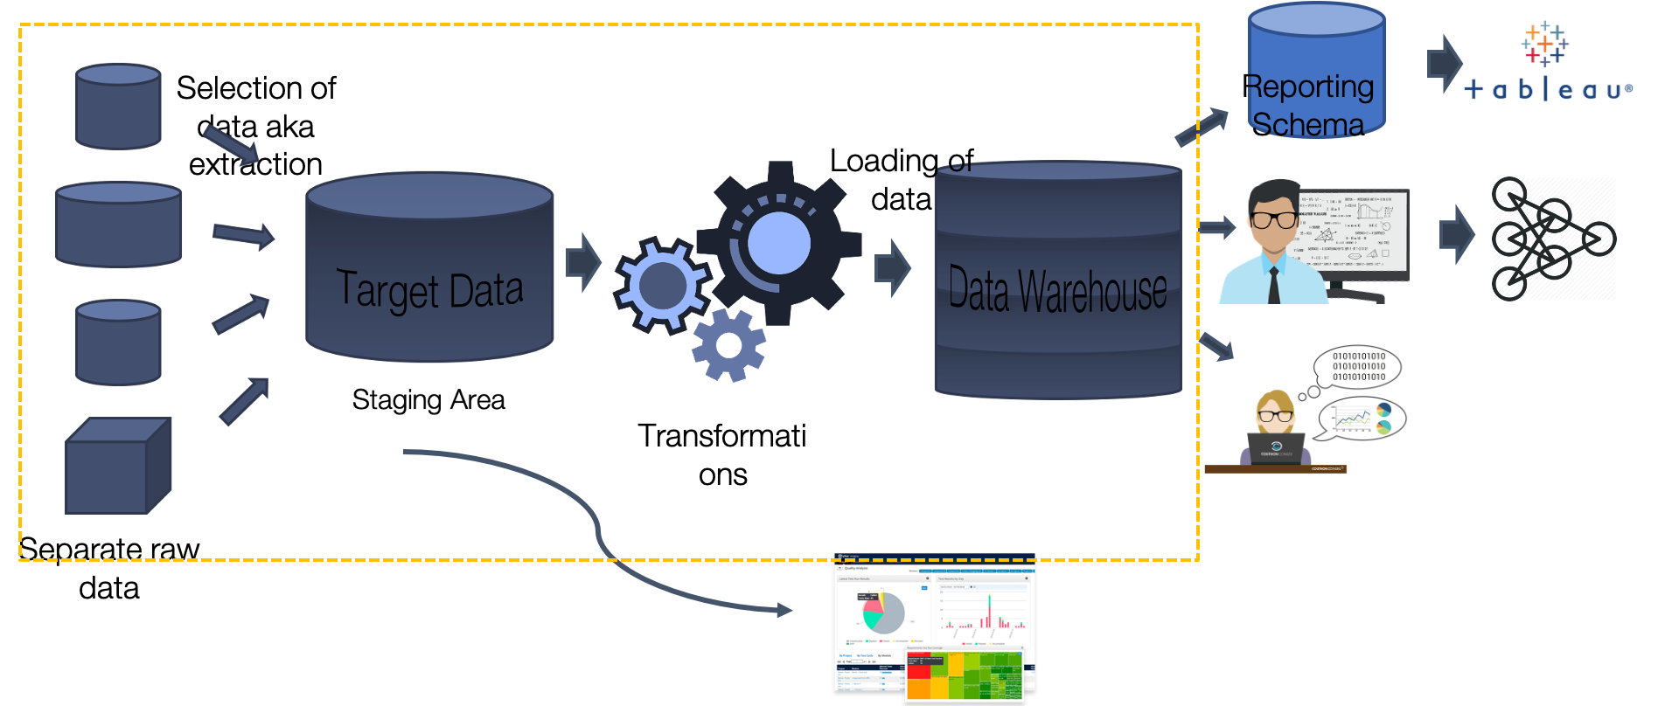
All the Roles
DBA
Data Engineer
BI Engineer
Analyst
Product
Notes:
https://www.youtube.com/watch?v=9w-_-BB5RfQ – 35:20 – 38:20
Analytics engineer –
The larger the company or more old school you still see a clear separation of roles
DBA – team that’s essentially in charge of giving access to the tools, think roles, privileges etc.… they might also be in charge of servers and clusters
Data engineer – gets the data into the database – they work with the tagging and getting your basic transformations set up
BI engineer – they work with the large transformations to the main tables that the teams rely on ... Think aggregated data or LTS or LTV
Analyst community – pull the basic reports and work with product

Slide 5
All the Roles
Data Engineer
Analyst
Product
Data Science
Notes:
https://www.youtube.com/watch?v=9w-_-BB5RfQ – 35:20 – 38:20
Analytics engineer –
Well time’s changing! Data engineers are merging with BI engineers which are merging with analysts… there is less of a distinction and a big gray area plus the addition of Data scientists who also have an engineering coding background

Slide 6
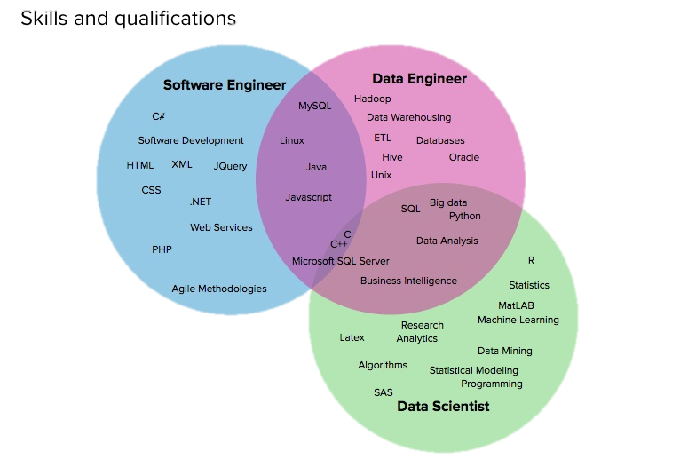
Role of a Data Engineer

Slide 7
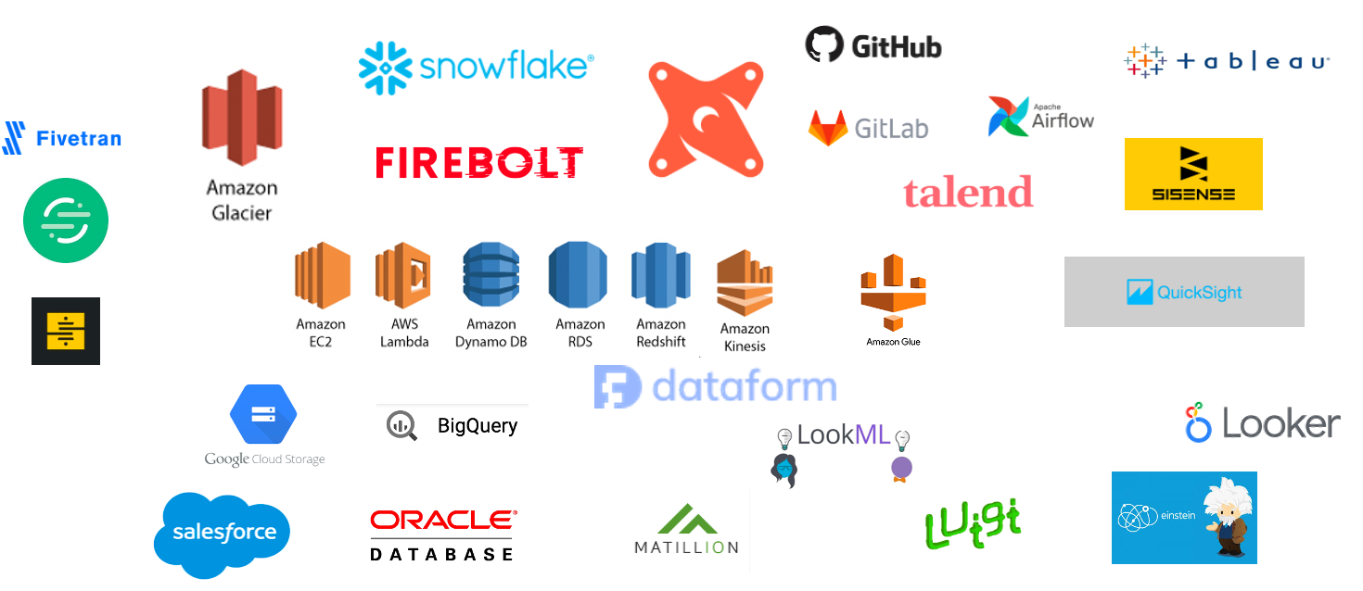
All the Tools
Notes:
Let’s talk about all the tools and all the possibilities out there… These are just some of the ones I have worked with. Every company is making their own too
Unnamed – segment – green
stitch – black and yellow

Slide 8


How do They Work Together
With so many tools out there how do you choose the best system for you team.
Take into consideration what is the current set up.
What are the roadblocks?
Is it scaling for you?
Is the price getting out of hand?
Will training help or do you need an entire new system

Slide 9
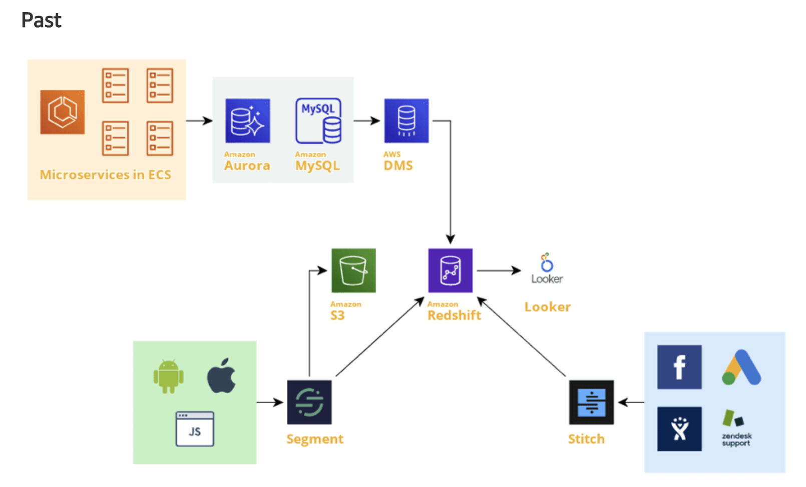
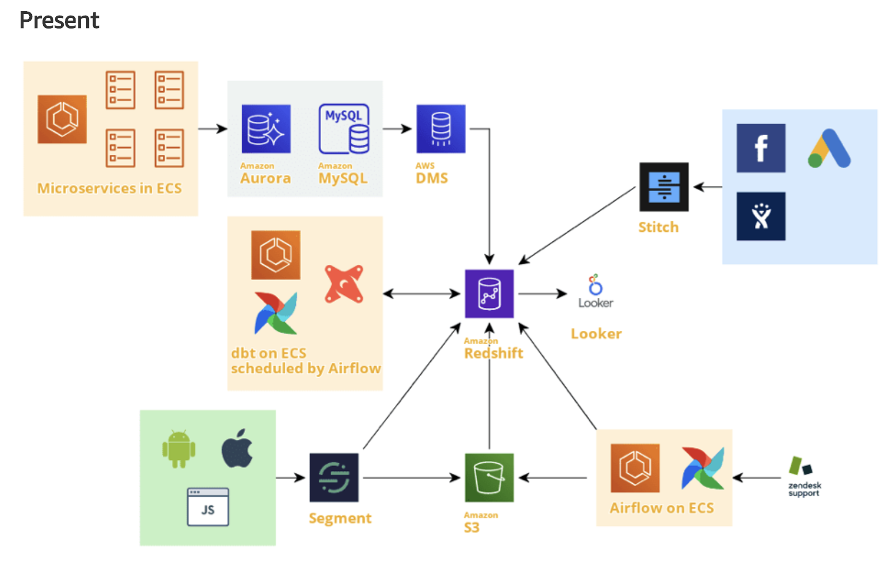
Data Design Study
Notes:
Here is the old data model from a business banking platform
They made a transition in about 6 months from the past to the present
They had a analytics platform in place but it was not being utilized… it was more just a link for
The transactional databases (MySQL and Amazon Aurora) and Looker (used for data visualization)
● AWS Database Migration Service (DMS) tasks moving data from transactional databases (MySQL and Amazon Aurora) to Amazon Redshift
● Stitch moving external data (Zendesk, Facebook, Google) to Redshift
● Looker dashboards reading source data from Redshift
Issues identified
– the visualization tool was being used for heavy computations
- this can become very expensive for both time in looker and compute power in redshift
- solution is to move the computations out of looker and into a presentation layer within Redshift
Their DW only contained current data
No historic reporting
Solution implement S3 bucket
External transfers of data caused delays
limited control over the transfer of external data when using Stitch
bring these external transfers in-house and reduce the usage of 3rd party tool
introduced a cleaned integration and presentation layers in our data-warehouse.
The cleaned layer includes all data that is ingested from external sources and from the data-lake.
This data is then transformed into business entities and event tables, which live in the integration layer.
Lastly, they use the presentation layer in order to optimize the speed of our queries
They introduced dbt to help with the transformations
trained how to use it
started building models that clean and aggregate the data for Looker
Airflow was used to schedule
run once per day, some would run every 12 hours, and others would update tables every 30 min
data quality and data latency checks with alerts integrated into Slack so that everyone in the channel would get alerted in case of data issues
The Airflow DAG would read the data from Zendesk’s API, add the new data to a daily partition in S3 in parquet format, and then copy the data from S3 to Redshift and deduplicate the old Redshift records so that we only had the current data
AWS Glue and external Spectrum tables in Redshift
DMS can use S3 as endpoint and write logs about inserts, updates, and deletes of the data

Slide 10
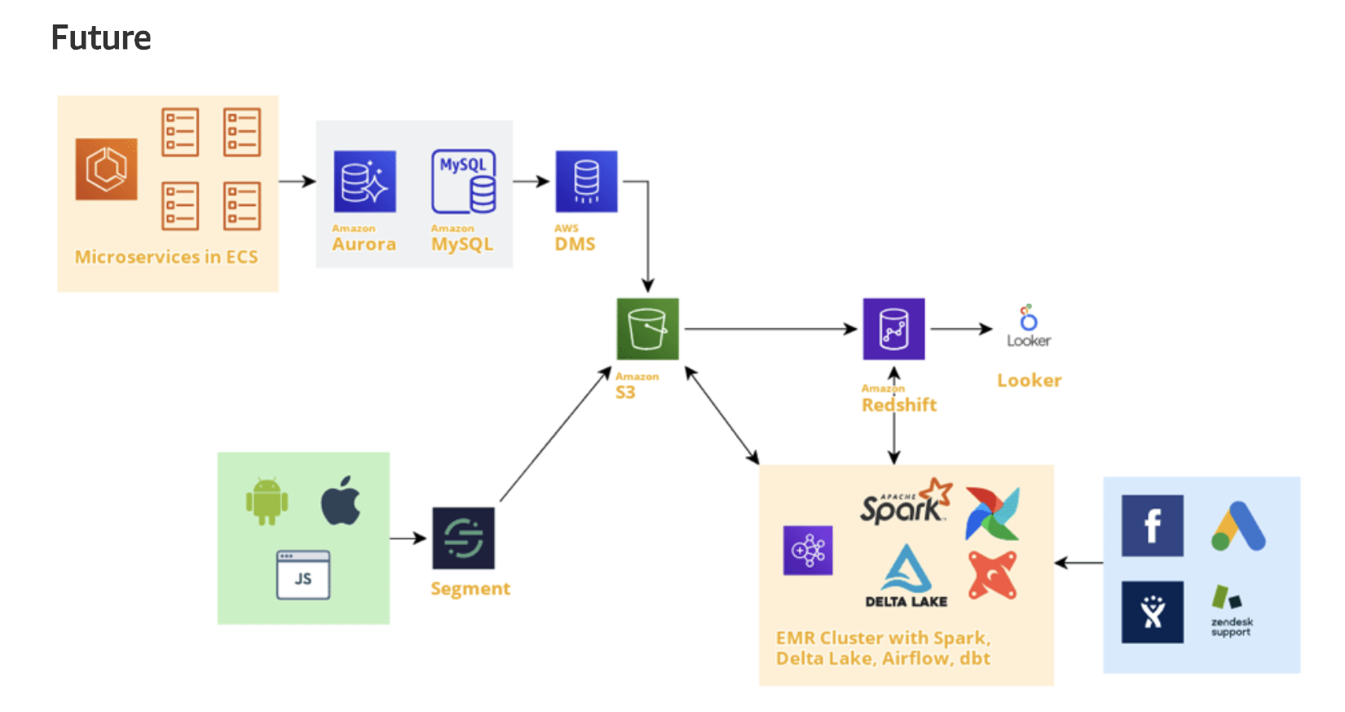
Data Design Study
Notes:
The plan for the Redshift layers and the migration of external data is to continue with what they’ve already started. they’ve already completed proofs of concept in these areas, but the complete migration will take months
an Amazon EMR cluster - enabling data scientists to process large amounts of data in memory
install Spark on the EMR cluster
Airflow to the EMR cluster and use Celery executor
Considering the frequency of our jobs (every 5 min) an EMR cluster is more cost effective than going serverless with AWS Glue
It is a nice mixture of open source software that has proven its value over the years and AWS services that are the backbone of the platform. It is one of the many possible designs for an analytics platform. It serves the specific needs of the company and will enable data analysts and data scientists to make data driven decisions.

Slide 11
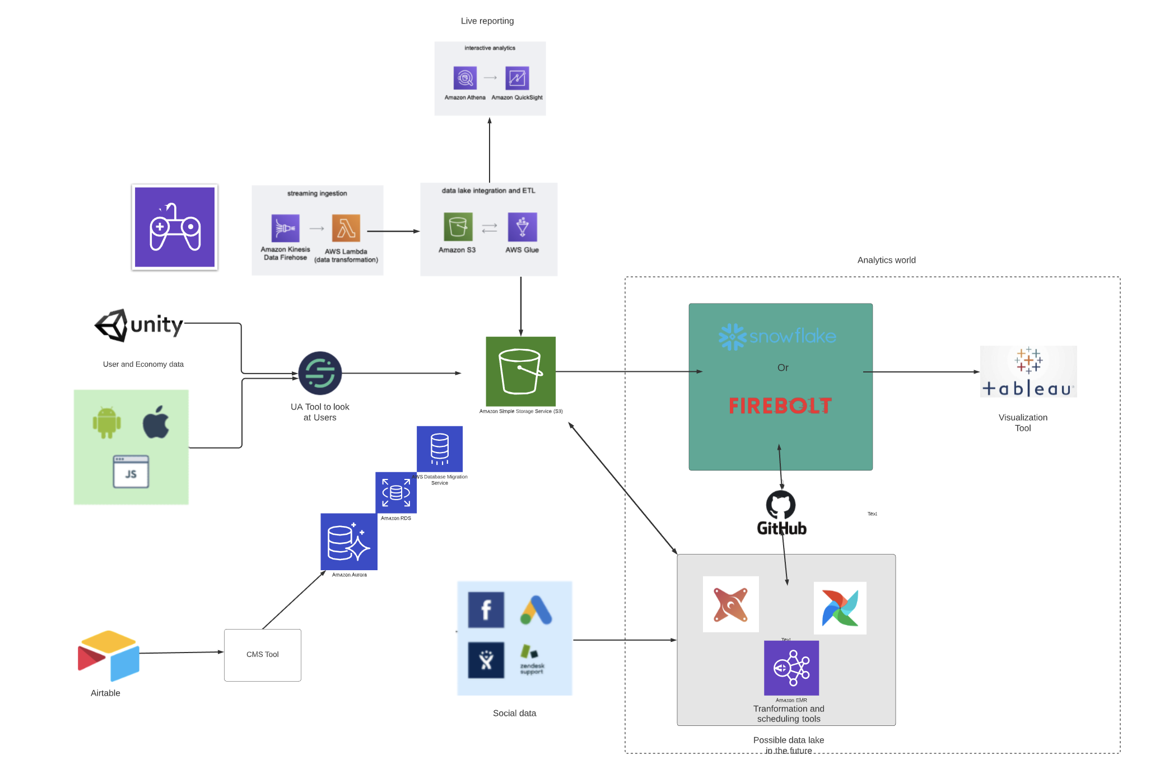
My Plan
Notes:
https://app.lucidchart.com/documents/edit/b237ae2e-cbaf-4649-822d-be7052211afc/soUdkZmiVXeJ?beaconFlowId=183BEA8822734595
Here’s a sneak peek into what I put together for the startup I’m currently consulting with.

Slide 12
Extract
Reproducibility
Analysis code — All analysis code should be checked into source control
Data sources — Also need to be stored in a non transformed format
Consistency (two methods)
Checking-in all code and data into a single revision control repository
Reserve source control for code and build a pipeline that explicitly depends on external data being in a stable, consistent format and location
Productionizability
A common Extract process that can be shared by all teams so that the data can be joined
Sharing introduces some complexities, but it also greatly reduces the potential for errors
Notes:
Are there various sources of data… well that’s a dumb question what company doesn’t have various sources.
Various sources internally
Third party
Reproducibility Additionally if there is any sampling the ”random” seed needs to be tracked so that it too can be reproduced
Consistency
Establishing consistency is of fundamental importance because data science obeys the maxim “garbage in, garbage out,”
For the first method you need small data sets, regular analytics, and a fixed source – these three items are pretty rare when we are talking about big data so source control to build a pipe line is the better way to go
in an external pipeline, securing your data sources is the key to consistent data and reproducible analysis
Productionizability
Common data format — In practice, there are a number of constraints to establishing a common data format.
Isolating library dependencies — You will want to isolate library dependencies used by your ETL in production.

Slide 13




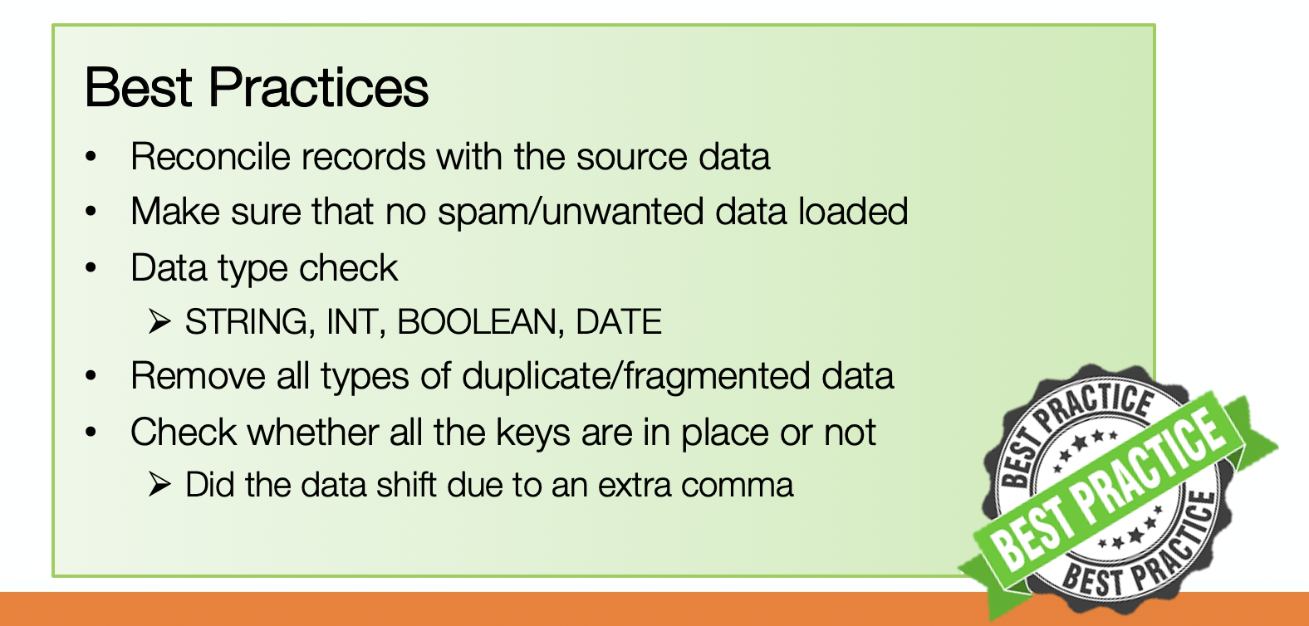
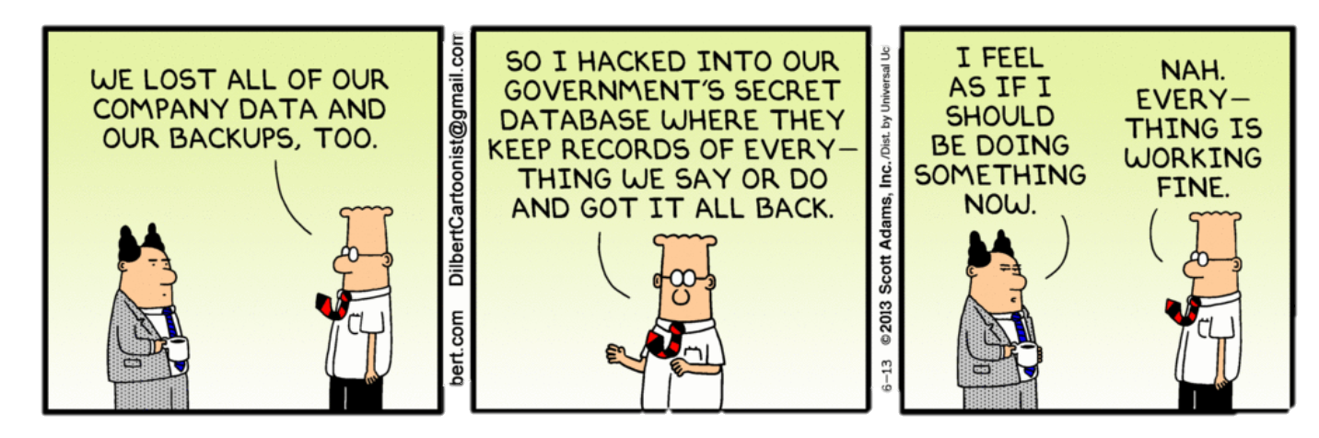
Extract
There are tools on the market that can help with this
Processes can also be implemented that do many of these same tasks
Notes:
Fivetran, segment, and stitch all work in similar ways where they transform the data a bit before the extract step. They help to connect all the data sources and create consistency across the metrics. Very useful in social data and UA .
Whether you ingest into an S3 bucket or directly into your data warehouse just be sure to track how it’s being done so that if it needs to be repeated or fixed due to missing data this can be done.
, feature extraction is an attribute reduction process, which results in a much smaller and richer set of attributes. Depending on the requirements, identifying and extracting informative and compact data sets (for an ML model) may need structured data like numbers and dates or unstructured data like categorical features and raw text. If the data volume is large, the feature extraction can be handled separately, and the generated features can be stored in the storage layer. The format of the stored features is ready for direct consumption by the ML training process in the next phase.
The feature extraction can be done for a wide range of applications like simple ETL process, model prediction pipeline, or retraining the model based on new data to improve the model accuracy. The processing can be done online (stream processing) or offline (batch processing). Processing data by the hour, day, or at fixed intervals can be considered as batch processing, whereas data processed under the fraction of a minute/second can be considered as stream processing. The processing type varies based on the data availability and the use case at hand.

Slide 14
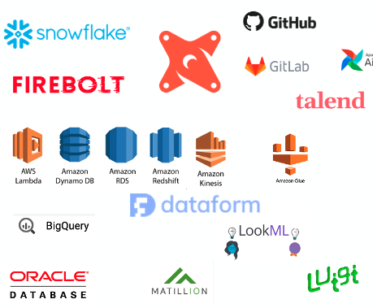
Transform
Transformation is the meat to the ETL or ELT
Transformations can make or break the data design
Strong models of Transformed data will allow for fast and useable analytics
Transformations can also be the highest compute charge if not managed well

Slide 15
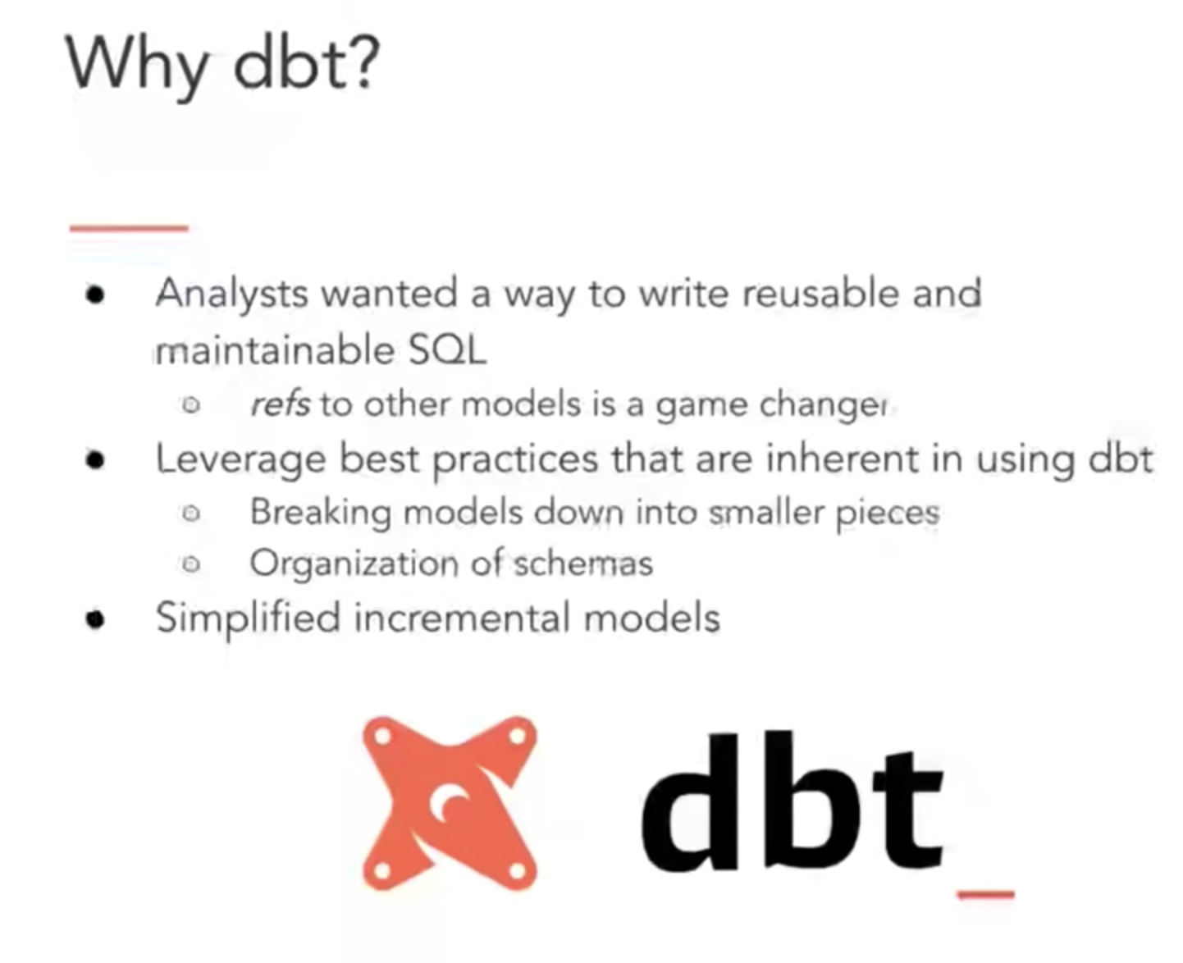
Notes:
You all are using dbt to do this so let’s take a second to review why

Slide 16


Load
Load data to optimize micro-partitions
Load data incrementally
Enforce idempotency with tests and the right data warehouses
Parameterize Workflow
Add Data Checks Early and Often
Build Useful Alerts & Monitoring System
Notes:
Finally, we also have special operators that Transfers data from one place to another, which often maps to the Load step in ETL. At Airbnb, we use MySqlToHiveTransfer or S3ToHiveTransfer pretty often, but this largely depends on one’s data infrastructure and where the data warehouse lives.
Partition Data Tables: As we mentioned earlier, data partitioning can be especially useful when dealing with large-size tables with a long history. When data is partitioned using datestamps, we can leverage dynamic partitions to parallelize backfilling.
Load Data Incrementally: This principle makes your ETL more modular and manageable, especially when building dimension tables from the fact tables. In each run, we only need to append the new transactions to the dimension table from previous date partition instead of scanning the entire fact history.
Enforce Idempotency: Many data scientists rely on point-in-time snapshots to perform historical analysis. This means the underlying source table should not be mutable as time progresses, otherwise we would get a different answer. Pipeline should be built so that the same query, when run against the same business logic and time range, returns the same result. This property has a fancy name called Idempotency.
Parameterize Workflow: Just like how templates greatly simplified the organization of HTML pages, Jinja can be used in conjunction with SQL. As we mentioned earlier, one common usage of Jinja template is to incorporate the backfilling logic into a typical Hive query. Stitch Fix has a very nice post that summarized how they use this technique for their ETL.
Add Data Checks Early and Often: When processing data, it is useful to write data into a staging table, check the data quality, and only then exchange the staging table with the final production table. At Airbnb, we call this the stage-check-exchange paradigm. Checks in this 3-step paradigm are important defensive mechanisms — they can be simple checks such as counting if the total number of records is greater than 0 or something as complex as an anomaly detection system that checks for unseen categories or outliers.
Build Useful Alerts & Monitoring System: Since ETL jobs can often take a long time to run, it’s useful to add alerts and monitoring to them so we do not have to keep an eye on the progress of the DAG constantly. Different companies monitor DAGs in many creative ways — at Airbnb, we regularly use EmailOperators to send alert emails for jobs missing SLAs. Other teams have used alerts to flag experiment imbalances. Yet another interesting example is from Zymergen where they report model performance metrics such as R-squared with a SlackOperator.

Slide 17
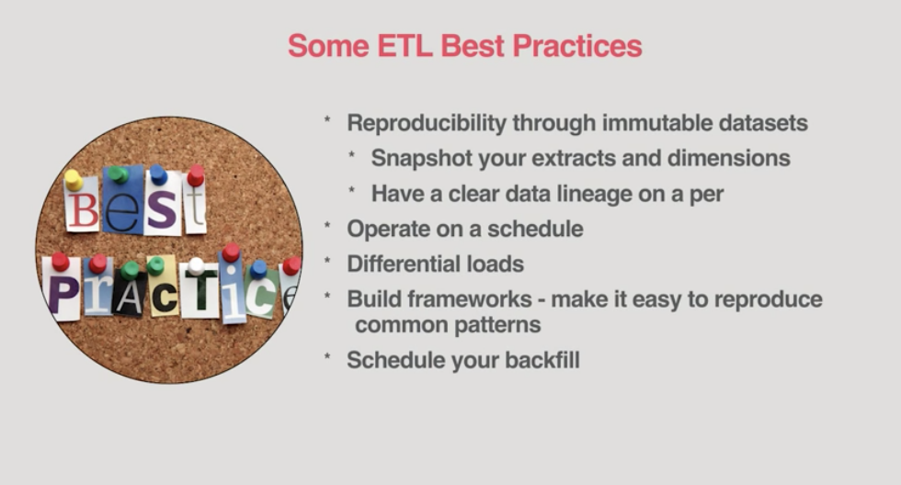
ETL Best Practices

Slide 18
Deployment Plan
The deployment plan describes each step of the deployment process at each deployment location
This can include Deployment of …
A new Data Warehouse
A new tool like dbt
A new model
An Updated model
Backfill of historical data
No matter what is being Deployed a Plan in needed
Notes:
The deployment plan outlines the scope, approach and execution planned for the deployment of the project deliverables. The plan includes, where relevant, information about system support, issue tracking, escalation processes, roles and responsibilities before, during, and after deployment. The deployment plan is intended to provide clients, stakeholders and support personnel with a smooth transition to the new product or software being deployed. The deployment plan describes each step of the deployment process at each deployment location, whether there is one site or multiple sites, or one deployment or a phased deployment planned. The Deployment Plan defines all of the work steps for complete deployment, and who does them.
Release Plan –
Describe the activities for a phased implementation or roll-out. Track the dates for the release of various functions, and/or track the formal review points in the testing cycle of your product. Your release plan may also include the following activities, as appropriate:
Preparation of the environment
Conversion information
Product installation information
Distribution details
Data Migration
Production Readiness
Create a Product Implementation Task List. Describe what preparation is required for this new tool or application to operate. Specify any features that need modification to adapt to the new product. Identify the steps necessary to assist the user in preparing for this new product.
Communication plan
Develop a plan to communicate with all interested parties of this project (stakeholders, sponsors, users, developers, Change Review Board)
Issue/Change Request Tracking Method
Project issues and their associated actions and owners
Project decisions and reasons
Backout Plan
Plan for what to do when something goes wrong during deployment, including how to go back to prior business processes and applications. Engage the appropriate sections of the Communications Plan.
Training Plan
Outline the training timeline and describe the approach, activities and tasks necessary at each point in the deployment.

Slide 19


Action Plan
Release Plan
Production Readiness
Communication plan
Issue/Change Request Tracking Method
Backout Plan
Training Plan
Notes:
Release Plan –
Describe the activities for a phased implementation or roll-out. Track the dates for the release of various functions, and/or track the formal review points in the testing cycle of your product. Your release plan may also include the following activities, as appropriate:
Preparation of the environment
Conversion information
Product installation information
Distribution details
Data Migration
Production Readiness
Create a Product Implementation Task List. Describe what preparation is required for this new tool or application to operate. Specify any features that need modification to adapt to the new product. Identify the steps necessary to assist the user in preparing for this new product.
Communication plan
Develop a plan to communicate with all interested parties of this project (stakeholders, sponsors, users, developers, Change Review Board)
Issue/Change Request Tracking Method
Project issues and their associated actions and owners
Project decisions and reasons
Backout Plan
Plan for what to do when something goes wrong during deployment, including how to go back to prior business processes and applications. Engage the appropriate sections of the Communications Plan.
Training Plan
Outline the training timeline and describe the approach, activities and tasks necessary at each point in the deployment.

Slide 20
Cultural Shift

Slide 21
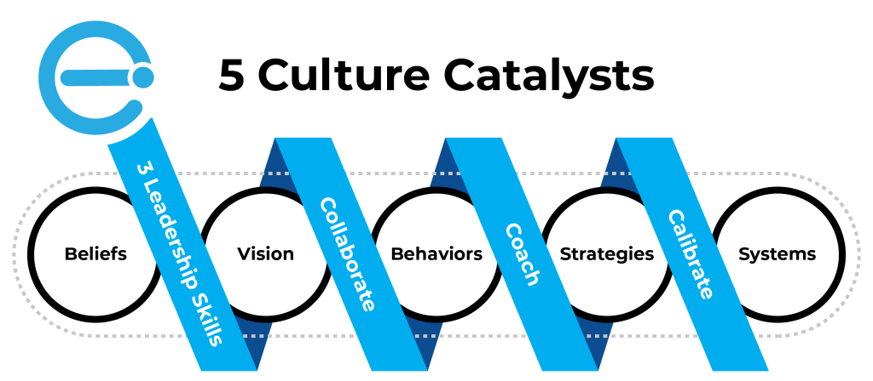
Ease Into Changes

Slide 22

Confused? ASK QUESTIONS

Slide 23
Break & Lab 4
Notes:
DBT implementing a new tool

